Slide 1


Milestone 2 Review
Measurement Phase Complete
Cost Data Integrity Project
October 19, 2007

Slide 2
Introduction
Project Definition Phase is fully complete – We have a good set of Operating Definitions to drive the Measurement Phase
Preliminary Data Review – We know what needs to be measured and analyzed going forward: Timesheets and Vendor Invoices
Baseline levels of performance are now established to move us into analysis and improvement

Slide 3
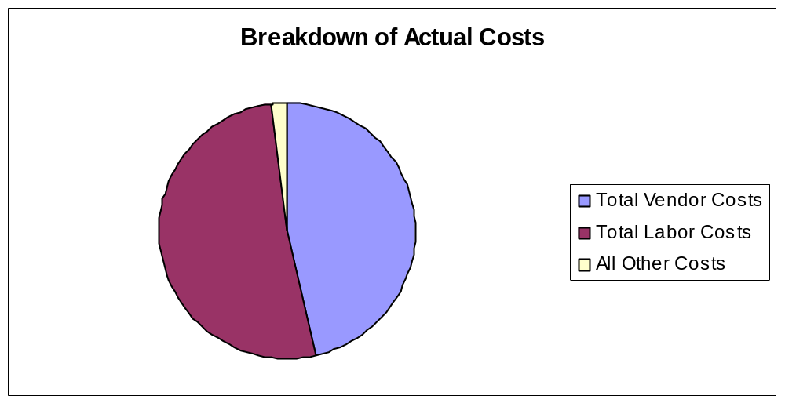
The Vital Few
What have you decided to measure?
Based on the January 2007 actual costs, we will focus on two big areas: Direct Labor Costs and Vendor Invoices. Regarding direct labor costs, we will look at two critical data sources: Rates and Hours. Regarding vendor invoices, we will measure two things: Timely posting of the invoices into the Project Management System and correct posting of the amounts. These are the vital few attributes that will get measured.

Slide 4
Results of Preliminary Analysis
Two Preliminary Tests:
  Compared January 2007 General Ledger Costs to Project Management System
  Compared assigned employees to submitted timesheets in Project Management System
Labor Rates are updated, but may not be accurate
Timesheet Processing is Broken: Not all employees assigned to projects are submitting timesheets into the Project Management System!
Vendor Invoice Processing is Broken: Invoices not entered at all on several projects!
Distortions to Actual Costs appear to be material – additional testing is required

Slide 5
Validating the Measurements
What techniques were used to validate your measurement data?
Attribute Measurement System Analysis was applied to each Operating Definition that we measured. This is a basic Gage R & R tool to make sure we have repeatability and reproducibility:
  Repeatable – Are we coming up with the same measurement values given each observer (three used / two trial runs)?
  Reproducibility – Are we coming up with the same measurement values across all three observers?
What are the results of your MSA (Measurement System Analysis)?
Everything was acceptable except for our testing of timesheet accuracy. We had to revise the procedure and standards so that we had a better listing of activity codes to test against. This eliminated the bias. The results of our MSA are listed on the next slide ►

Slide 6
MSA Results
Gage R & R
Observers / Appraisers
SM | RB | JM | All | Description of Measurement
100% | 100% | 100% | 100% | Base Pay Rates agree to Source System Data
100% | 100% | 95% | 95% | Fringe Rates agree to Source System Data
100% | 100% | 100% | 100% | Timesheets submitted in a timely manner
100% | 100% | 100% | 90% | Timesheets are complete
95% | 100% | 100% | 75% * | Timesheets are accurately coded
100% | 100% | 95% | 90% | Vendor invoices posted in a timely manner
100% | 100% | 95% | 90% | Vendor invoice amounts posted correctly
* Revised the operational definition to include a standard listing of activity codes to improve MSA results to an acceptable level.

Slide 7
Baseline Performance
What is the current baseline level of performance?
Critical to Quality Characteristic | Sigma Level | Monetary Impact
Timely processing of timesheets into PMS | 2.64 | 16%
Timesheets are complete in terms of hours | 3.32 | 1%
Timesheets are accurate in terms of coding | 3.12 | 1%
Base Rate of Pay is +/- 1% accurate | 2.35 | 1%
Fringe Benefit Rate is +/- 1% accurate | 2.21 | 2%
Timely processing of vendor invoices into PMS | 1.21 | 77%
Vendor invoice amounts are accurate in PMS | 2.43 | 2%
Focus on two critical to quality defects:
Critical Defect No. 1 – Vendor Invoices not posted to PMS
Critical Defect No. 2 – Timesheets not posted to PMS

Slide 8
Project Performance
Is this project on schedule according to the project plan?
The project is 8 days behind schedule as a result of team members pulling off to do other work. We still expect to meet the overall end-date since the analysis phase and improvement phases should move rather quickly.
Is this project on budget according to the project budget?
The project is under-budget since a few team members were pulled off the project temporarily for surge support work on other projects.
Total costs incurred to date (as of September 15, 2007) . $ 140,000 (27% spent)
Project Budget . . . . . . . . . . . . . . . . . . . . . . . . . . . . . . . . . . $ 522,000
Remaining Budget . . . . . . . . . . . . . . . . . . . . . . . . . . . . . . . $ 382,000

Slide 9

Questions and Comments

